Slide 1
Direct Memory Access (DMA) Operation and DMA Controller

Slide 2
Basic DMA concept
Direct memory access (DMA) is a feature of modern computer systems that allows certain hardware subsystems to read/write data to/from memory without microprocessor intervention, allowing the processor to do other work.
Used in disk controllers, video/sound cards etc, or between memory locations.

Slide 3
Typically, the CPU initiates DMA transfer, does other operations while the transfer is in progress, and receives an interrupt from the DMA controller once the operation is complete.
Can create cache coherency problems (the data in the cache may be different from the data in the external memory after DMA)

Slide 4
Basic DMA Terminology
DMA channel: system pathway used by a device to transfer information directly to and from memory. There are usually 8 in a computer system
DMA controller: dedicated hardware used for controlling the DMA operation

Slide 5
Single-cycle mode: DMA data transfer is done one byte at a time
Burst-mode: DMA transfer is finished when all data has been moved

Slide 6
DMA Pins and Timing
x86 Interrupt Pins
HOLD: DMA request
Sampled in the middle of any clocking cycle
HLDA: DMA acknowledge signal.
The address, data and control buses are set to high-Z, so the I/O devices can control the system bus

Slide 7
DMA on the 8086 Microprocessor
The I/O device asserts the appropriate signal for the channel.
The DMA controller will enable appropriate channel, and ask the CPU to release the bus so that the DMA may use the bus. The DMA requests the bus by asserting the HOLD signal which goes to the CPU.

Slide 8
The CPU detects the HOLD signal, and will complete executing the current instruction. Now all of the signals normally generated by the CPU are placed in a tri-stated condition (neither high or low) and then the CPU asserts the HLDA signal which tells the DMA controller that it is now in charge of the bus.

Slide 9
The CPU may have to wait (hold cycles).
DMA activates its MEMR, MEMW, IOR, IOW output signals, and the address outputs from the DMA are set to the target address, which will be used to direct the byte that is about to transferred to a specific memory location.

Slide 10
The DMA will then let the device that requested the DMA transfer know that the transfer is commencing by asserting the DACK signal.
The peripheral places the byte to be transferred on the bus Data lines.

Slide 11
Once the data has been transferred, The DMA will de-assert the DACK2 signal.
The DMA will now check to see if any of the other DMA channels have any work to do. If none of the channels have their DRQ lines asserted, the DMA controller has completed its work and will now tri-state the MEMR, MEMW, IOR, IOW and address signals.

Slide 12
Finally, the DMA will de-assert the HOLD signal. The CPU sees this, and de-asserts the HOLDA signal. Now the CPU resumes control of the buses and address lines, and it resumes executing instructions and accessing main memory and the peripherals.

Slide 13
8237 DMA Controller
Supplies memory and I/O with control signals and addresses during DMA transfer
4-channels (expandable)
0: DRAM refresh
1: Free
2: Floppy disk controller
3: Free

Slide 14
1.6 MByte/sec transfer rate
64 KByte section of memory address capability with single programming
“fly-by” controller (data does not pass through the DMA-only memory to I/O transfer capability)
Initialization involves writing into each channel:
i) The address of the first byte of the block of data that must be transferred (called the base address).
ii) The number of bytes to be transferred (called the word count).

Slide 15
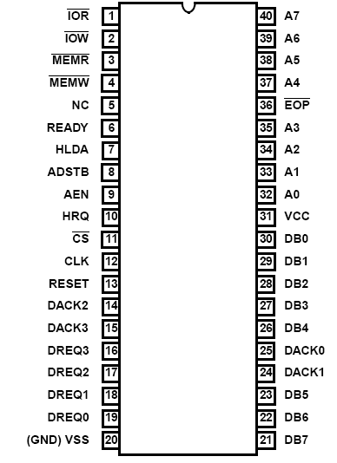
8237 pins
CLK: System clock
CS΄: Chip select (decoder output)
RESET: Clears registers, sets mask register
READY: 0 for inserting wait states
HLDA: Signals that the μp has relinquished buses
DREQ3 – DREQ0: DMA request input for each channel
DB7-DB0: Data bus pins
IOR΄: Bidirectional pin used during programming
and during a DMA write cycle
IOW΄: Bidirectional pin used during programming
and during a DMA read cycle
EOP΄: End of process is a bidirectional signal used as input to terminate a DMA process or as output to signal the end of the DMA transfer
A3-A0: Address pins for selecting internal registers
A7-A4: Outputs that provide part of the DMA transfer address
HRQ: DMA request output
DACK3-DACK0: DMA acknowledge for each channel.
AEN: Address enable signal
ADSTB: Address strobe
MEMR΄: Memory read output used in DMA read cycle
MEMW΄: Memory write output used in DMA write cycle

Slide 16
8237 DMA Application

Slide 17
8237 registers
CAR (Current Address Register): holds the 16-bit memory address used for the DMA transfer (one for each channel), either incremented or decremented during the operation
CWCR (Current Word Count Register): Programs a channel for the number of bytes (up to 64K) transferred during a DMA operation
BA (Base Address) and WC (Word Count): Used when auto-initialization is selected for a channel, to reload the CAR and CWCR when DMA is complete.
CR (Command Register): Programs the operation of the controller

Slide 18
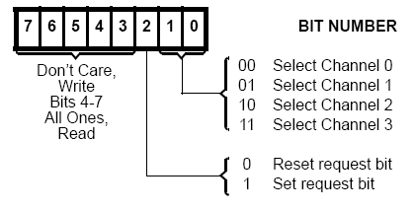
MR (Mode Register): Programs the mode of operation for a channel (one for each channel).
RR (Request Register): Used to request DMA transfer via software (memory-to-memory transfers)

Slide 19
MR (Mask Register):
SR (Status Register): Shows the status of each DMA channel

Slide 20
8237 Software commands

Slide 21
8237 Software commands
Clear First/Last Flip-Flop - This command is executed prior to writing or reading new address or word count information to the 82C37.
Set First/Last Flip-Flop - This command will set the flip-flop to select the high byte first on read and write operations to address and word count registers.
Master Clear - This software instruction has the same effect as the hardware Reset.
Clear Mask Register - This command clears the mask bits of all four channels, enabling them to accept DMA requests.
Clear Mode Register Counter- An internal two-bit counter has been included to select Mode registers during read operation.

Slide 22
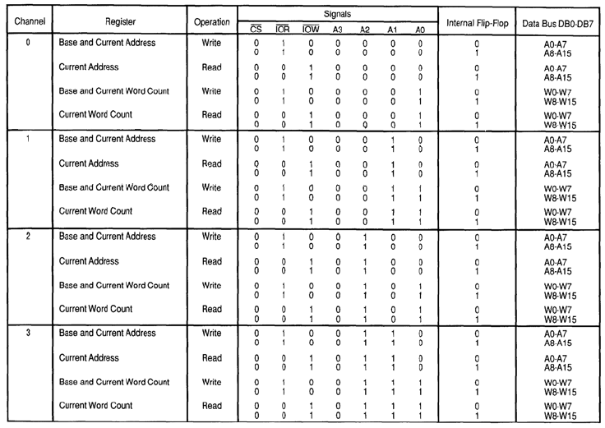
8237 CHANNEL I/O PORT ADDRESSES

Slide 23
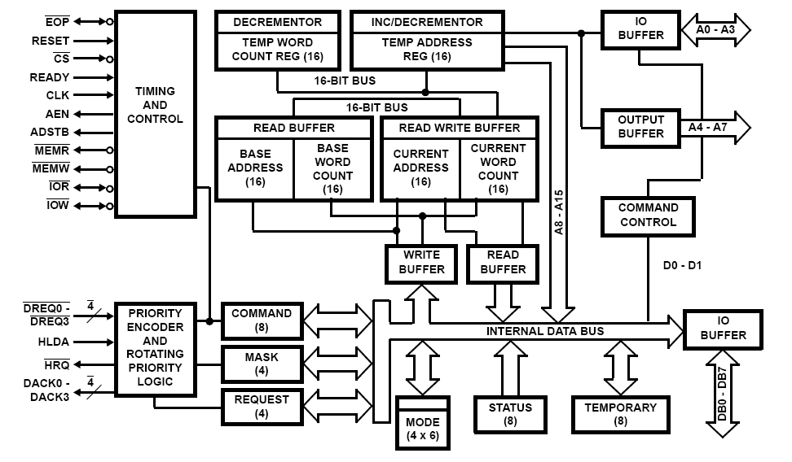
8237 Block Diagram

Slide 24
Initiating a DMA Transaction
Save the current interrupt status and disable interrupts
Disable the channel that will be used for the transaction
Reset the flip-flop
Set the Mode Register
Set the Page Register
Set the Offset Register
Set the Block Size Register
Enable the channel that is used for the transaction
Restore the interrupt status

Slide 25
Programming the 8237
First program the address and count registers first:
1. Clear the F/L flip-flop with a clear F/L command
2. Disable the channel
3. Program the LSB and then MSB of the address
4. Program the LSB and then MSB of the count
Select the mode of operation
Enable channel

Slide 26
Example
Design the 8237 decoding circuit and the 8237 address line connections so that the 8237 is in the address range 70h-7Fh
Write a program that starts a block memory-to-memory DMA transfer from memory locations 10000H-13FFFH to 140000H-17FFFH using channel 0 as source and channel 1 as destination.

Slide 27
CLEAR_FF EQU 7CH ;F/L CLEAR VALUE
CH0_A EQU 70H ;CHANNEL 0 ADDRESS
CH1_A EQU 72H ;CHANNEL 1 ADDRESS
CH1_C EQU 73H ;CHANNEL 1 COUNT
MODE EQU 7BH ;MODE
CR EQU 78H ;COMMAND REGISTER
MASKS EQU 7FH ;MASKS
REQ EQU 79H ;REQUEST REGISTER
STATUS EQU 78H ;STATUS REGISTER
;ES = segment of source and destination
;SI = source address
;DI = destination address
;CX = count
DMA PROC FAR
MOV AL, 0
OUT CLEAR_FF, AL ;CLEAR F/L FF
MOV AX, ES ;PROGRAM SOURCE ADDRESS
SHL AX, 4 ;SHIFT LEFT SEGMENT
ADD AX, SI ;ADD SOURCE OFFSET
OUT CH0_A, AL ;CHANNEL 0 ADDRESS PROGRAMMING LSB FIRST
MOV AL, AH ;ONLY AL ALLOWED IN IN/OUT INSTRUCTIONS
OUT CH0_A, AL ;CHANNEL 0 ADDRESS PROGRAMMING MSB LAST

Slide 28
MOV AX, ES ;PROGRAM DESTINATION ADDRESS
SHL AX, 4 ;SHIFT LEFT SEGMENT
ADD AX, DI ;ADD DESTINATION OFFSET
OUT CH1_A, AL ;CHANNEL 1 ADDRESS PROGRAMMING LSB FIRST
MOV AL, AH ;ONLY AL ALLOWED IN IN/OUT INSTRUCTIONS
OUT CH1_A, AL ;CHANNEL 1 ADDRESS PROGRAMMING MSB FIRST
MOV AX, CX ;PROGRAM COUNT
DEC AX ;ADJUST COUNT
OUT CH1_C, AL ;MOVE TO CHANNEL 1 COUNT
MOV AL, AH
OUT CH1_C, AL
MOV AL, 88H ;PROGRAM MODE
OUT MODE, AL
MOV AL,1 ;MEMORY-TO-MEMORY TRANSFER
OUT CR, AL
MOV AL, 0EH ;UNMASK CHANNEL 0
OUT MASKS, AL
MOV AL, 4 ;START DMA TRANSFER BY SETTING REQUEST BIT FOR CHANNEL 2
OUT REQ, AL

Slide 29
Direct Memory Channel Improvement
Interrupt processing
Peripheral module to perform DMA.
Bus arbitrator.
There can only be one user of the data bus so processor must wait if DMA is transferring data.
DMA controller tells the processor when the DMA has completed the transfer.

Slide 30
DMA Block Diagram
Interrupt line
CPU
cycle state signals
DMA Module
External
I/O lines
address setup
Address bus
Data bus
RAM
Notes:
Programming the DMA module for a transfer requires setting the DMA registers, setting the base address of the memory block to tranfer to/from and also setting the number of bytes to transfer. DMA module contains an address generator (to increment or decrement addresses) and a comparison hardware (to match an address with the end address).

Slide 31
Sharing of the op-code cycles
RAM access
Read the OP code from program memory (fetch)
Read/write data from/to data RAM addresses (decode and writeback)
CPU operations (execute)
Perform data manipulation
DMA device performs RAM access during this second portion of the op-code cycle

Slide 32
DMA Controller in BF533
• Between memory and memory (MDMA) (Memory DMA)
• Between memory and the I/O through a serial or parallel port.
There are 12 DMA channels for various transfers.
Two ways of programming DMA transfers
Descriptor-based
Register-based

Slide 33
Descriptor-based DMA
Transfers require a set of parameters stored within memory to initiate a DMA sequence.
Allows the chaining together of multiple DMA sequences.
DMA channel can be programmed to automatically set up and start another DMA transfer after the current sequence completes.

Slide 34
Register-based DMA
Allows the processor to directly program DMA control registers to initiate a DMA transfer.
On completion, the control registers may be automatically updated with their original setup values for continuous transfer, if needed.

Slide 35
DMA Registers
DMA registers fall into three categories:
Parameter registers, such as
DMAx_CONFIG and DMAx_X_COUNT
Current registers, such as DMAx_CURR_ADDR and DMAx_CURR_X_COUNT
• Control/Status registers, such as DMAx_IRQ_STATUS and DMAx_PERIPHERAL_MAP

Slide 36
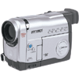

Video Interface
DMA
VideoInPort
Decoder
Video source
PPI Interface
Memory
Display Unit
PPI Interface
VideoOutPort
Encoder
BF533

Slide 37
Example code for video Input
//Configure the Interrupt service routine
CALL BF533_EZ_KIT_ISR_Config;
//Configure the SDRAM
CALL BF533_EZ_KIT_SDRAM_Config;
//Configure the DMA in Stop Mode
CALL BF533_EZ_KIT_DMA_Config;
//Configure the PPI 8bit, ITU-656 mode, Input Mode, Active Field Only......
CALL BF533_EZ_KIT_PPI_Config;

Slide 38
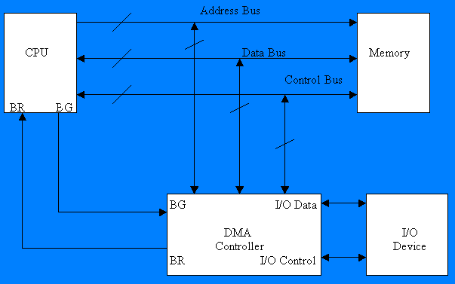
Computer System with DMA

Slide 39
Implementing DMA in a Computer
A DMA controller implements DMA in a computer system.
It connects directly to the I/O device at one end and to the system buses at the other end. It also interacts with the CPU, both via the system buses and two new direct connections.

Slide 40
Data Transfer using DMA Controller
To transfer data from an I/O device to memory, the DMA controller first sends a Bus Request (BR) to the CPU by setting BR to 1. When it is ready to grant this request, the CPU sets it’s Bus Grant (BG) signal to 1.
The CPU also tri-states it’s address,data, and control lines thus truly granting control of the system buses to the DMA controller.

Slide 41
Internal Configuration
DMA Address Register contains the memory address to be used in the data transfer.
DMA Count Register, also called Word Count Register, contains the no. of bytes of data to be transferred.
DMA Control Register accepts commands from the CPU. It is also treated as an O/P port by the CPU.
Status Register

Slide 42
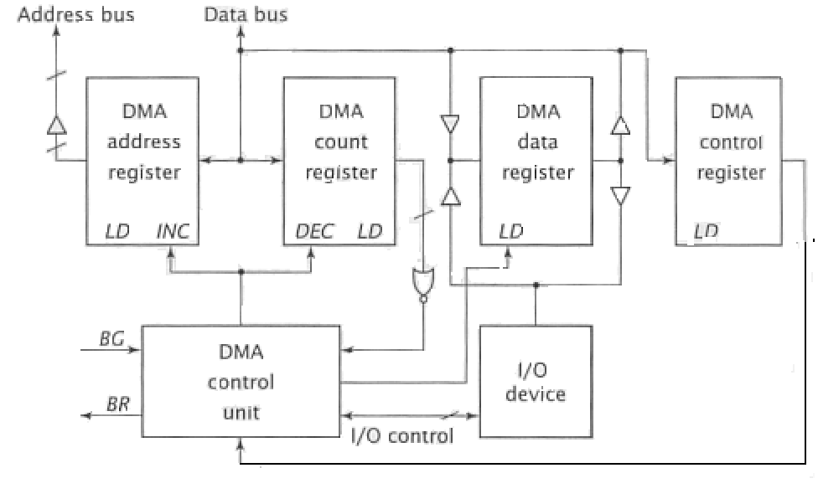
Internal Configuration of DMA Controller

Slide 43
Process of DMA Transfer
CPU loads the address of the first memory location of the memory block into the DMA address register. It does this via an I/O output instruction.
It then writes the no. of bytes to be transferred into the DMA count register in the sane manner.
Finally, it writes one or more commands to the DMA control register.

Slide 44
The last command causes the DMA controller to initiate the transfer. The controller then sets BR to 1 and, once BG becomes 1 , seizes control of the system buses.

Slide 45
DMA Transfer Modes
Modes vary by how the DMA controller determines
when to transfer data, but the actual data transfer
process is the same for all the modes.
BURST mode
Sometimes called Block Transfer Mode.
An entire block of data is transferred in one contiguous sequence. Once the DMA controller is granted access to the system buses by the CPU, it transfers all bytes of data in the data block before releasing control of the system buses back to the CPU.
This mode is useful for loading programs or data files into memory, but it does render the CPU inactive for relatively long periods of time.

Slide 46
CYCLE STEALING Mode
Viable alternative for systems in which the CPU should not be disabled for the length of time needed for Burst transfer modes.
DMA controller obtains access to the system buses as in burst mode, using BR & BG signals. However, it transfers one byte of data and then deasserts BR, returning control of the system buses to the CPU.

Slide 47
By continually obtaining and releasing control of the system buses, the DMA controller essentially interleaves instruction & data transfers. The CPU processes an instruction, then the DMA controller transfers a data value, and so on.
The data block is not transferred as quickly as in burst mode, but the CPU is not idled for as long as in that mode.
Useful for controllers monitoring data in real time.

Slide 48
TRANSPARENT Mode
This requires the most time to transfer a block of data, yet it is also the most efficient in terms of overall system performance.
The DMA controller only transfers data when the CPU is performing operations.
For example, the Relatively simple CPU has several states that move or process data solely within the CPU:
NOP1: (No operation)
LDAC5: AC←DR

Slide 49
JUMP3: PC←DR,TR
CLAC1: AC←0, Z←1
Primary advantage is that CPU never stops executing its programs and DMA transfer is free in terms of time.
Disadvantage is that the hardware needed to determine when the CPU is not using the system buses can be quite complex and relatively expensive.

Slide 50
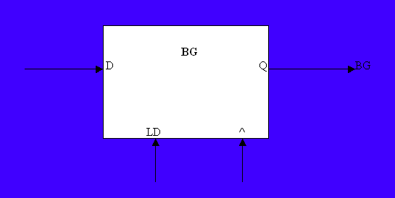
Hardware Implementation of BG

Slide 51

Modified State Diagram To Accommodate BR and BG

Slide 52
Advantages of DMA
Fast memory transfer of data
CPU and DMA run concurrently under cache mode
DMA can trigger an interrupt, which frees the CPU from polling the channel

Slide 53
DMA Hardware
NET+ARM
Peripheral
DMA
Receive Channel
Transmit Channel
RAM

Slide 54
DMA in Brief
10 Channels total
8 channels wired into NET+ARM modules
Ethernet, Serial, Parallel / ENI
2 Channels available for external Memory moves
Handshaking signals muxed into GPIO lines
Can move data while ARM executes from Cache
Simple Implementation
Good for repetitive data movement

Slide 55
Modes of Operation
Fly-by
Data is directly transferred between memory and the peripheral
Memory to Memory
Data is not directly transferred, but buffered in between transfers
Data is copied from the source location into a temporary area in the DMA channel, and then written into the destination location.

Slide 56
External DMA – Fly By
Net+ARM
DMA
Request
Peripheral
DMA
Controller
DMA
Grant
Add
Memory
DATA

Slide 57
Closer look at Fly-By Signaling
Net+ARM
DRQ*
DACK*
DONE*
R / W*
DATA[31:0]
ADDR[27:0]
CSx*
External Device
DRQ*
Enable
Done
Direction
DATA[31:0]
Memory
CS*
ADDR[X:0]
DATA[31:0]
R / W*

Slide 58
External DMA – Mem To Mem
Net+ARM
DMA
Request
Peripheral
DMA
Controller
DMA Grant
ADD
Holding FIFO
DATA
ADD
DATA
Memory

Slide 59
Closer Look at Mem to Mem Signaling
Net+ARM
DRQ*
DACK*
DONE*
R / W*
DATA[31:0]
ADDR[27:0]
CSx*
Csy*
External Device
DRQ*
Enable
Done
Direction
DATA[31:0]
ADDR[X:0]
CS*
Memory
CS*
ADDR[X:0]
DATA[31:0]
R / W*

Slide 60
Port A Special Function - DMA
PORTA7 / TXDA
PORTA6 / DTRA* / DRQ1*
PORTA5 / RTSA*
PORTA4 / OUT1A* / RXCA
PORTA3 / RXDA
PORTA2 / DSRA* / DACK1*
PORTA1 / CTSA*
PORTA0 / DCDA* / DONE1*
Port A Configuration
Pin MODE DIR
A6 1 0
A2 1 1
A0 1 1
DRQ1*
DACK1*
1st Xfer
2nd Xfer
Last Xfer
DONE1*
Rough Timing Diagram

